Slide 1
Events and Messages
CIDM 6330
Spring 2021

Slide 2
Aggregates
APP Chapter 7

Slide 3
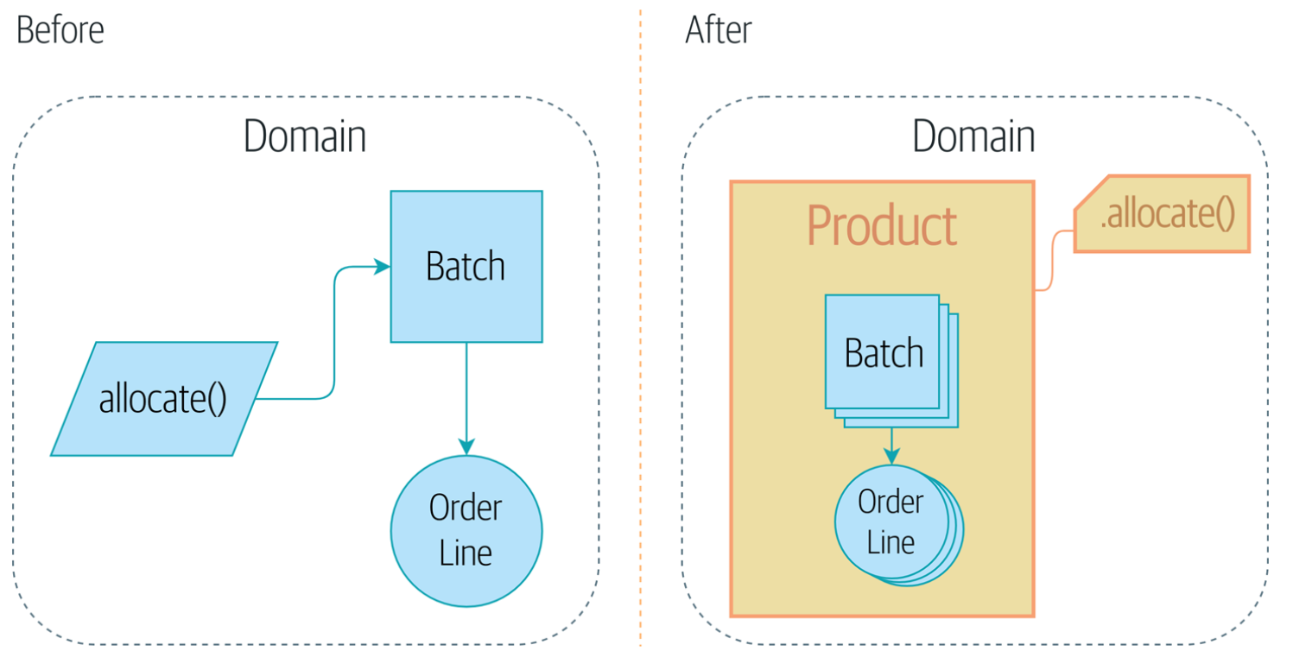
First, some words about aggregates

Slide 4
Why does this matter?
Invariants
The unalterable facts that must be modeled in the domain
Constraints
A business rule that restricts the possible states in the domain model
Consistency
The imperative to operate given invariants and constraints
Examples
“An order line can be allocated to only one batch at a time.”
“We can’t allocate to a batch if the available quantity is less than the quantity of the order line.”

Slide 5
The impacts on data consistency
Concurrency
In a multi-user/multi-process system, maintaining consistency is a challenge
Common Solution:
Locks: we lock a resource – such as a database – so that only one change is permitted at a time
Problem: With a larger system, locking the entire system per transaction creates a bottleneck

Slide 6
Aggregates to the Rescue
From the DDD community: An aggregate is a domain model that groups/contains other domain models
“An AGGREGATE is a cluster of associated objects that we treat as a unit for the purpose of data changes.” — Eric Evans
Also, aggregates can be designed to be the “public” interfaces to the domain model such that individual classes can be thought of as “private” data/value objects
Aggregates create bounded contexts
Lends well to the development of a “microservices” approach that Flask is often associated with

Slide 7
Aggregates and Repositories
We evolve our repository approach with the following design guidance:
One Aggregate = One Repository
Concurrency and Integrity require a bit more care…

Slide 8
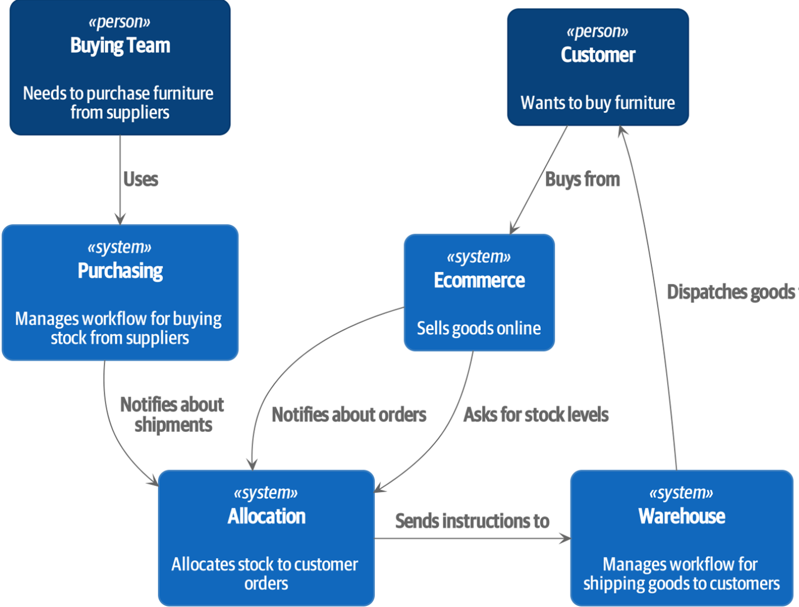
Back to the Big Picture

Slide 9
Events and the Message Bus
Chapter 8

Slide 10
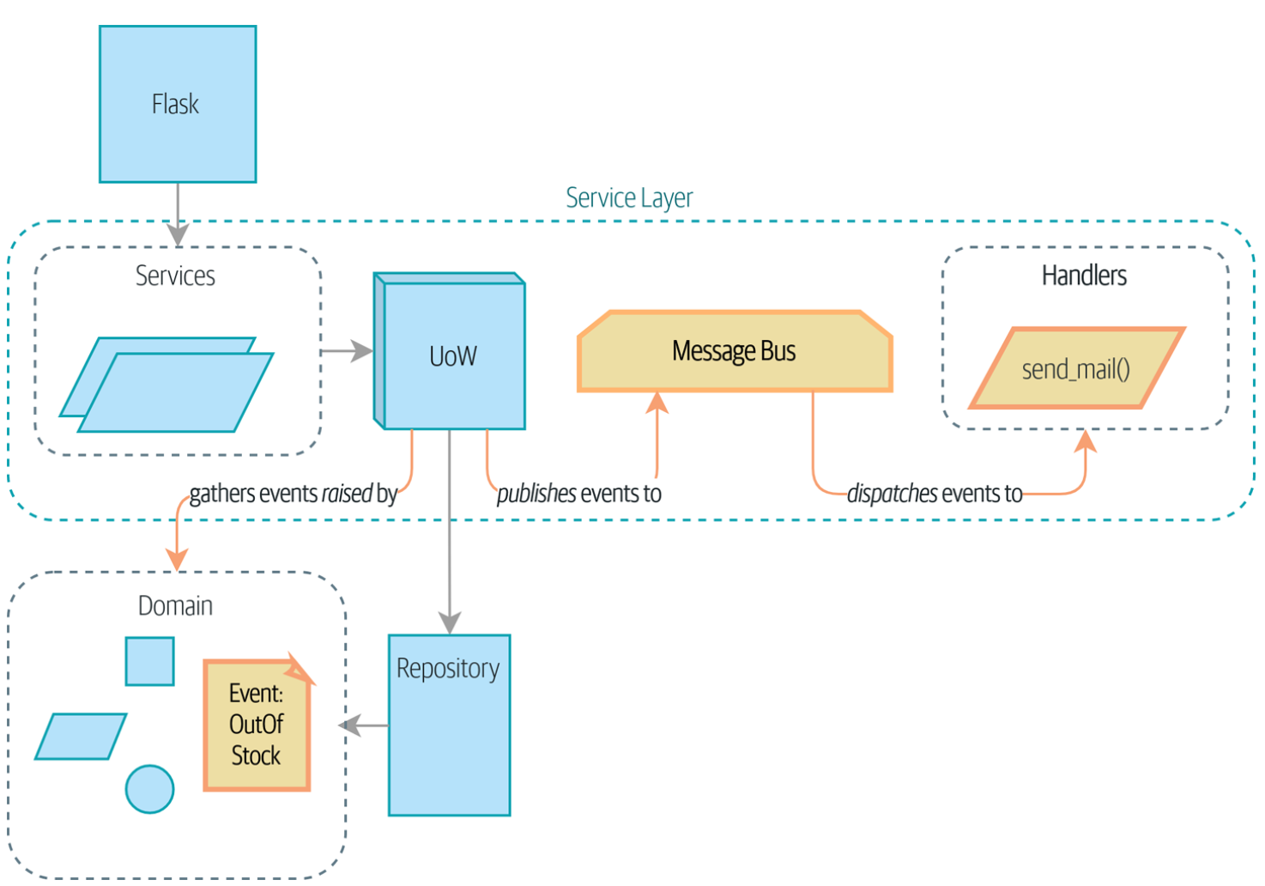
The Meaning of State Changes

Slide 11
Business Process Premise
“when we can’t allocate an order because we’re out of stock, we should alert the buying team. They’ll go and fix the problem by buying more stock, and all will be well.”
Where to place this logic/rule?
In the router/controller?
No, this is a request/response router and shouldn’t do heavy lifting
In the model?
Maybe, but no: sending email is an implementation detail – will we send email in the future? Do we still send telegraphs?
In the Service Layer?
No, this layer obeys the Single Responsibility Principle

Slide 12
We want to be notified…
While being out of stock in an important exception, we want to notify a specialist to handle this situation…
Patterns to handle this:
Domain Events
Message Bus
The model can certainly recognize a condition that impacts goal-seeking functioning
But that model should raise an event and broadcast that so that a specialist can react
An event will be developed as a Python Data Class

Slide 13
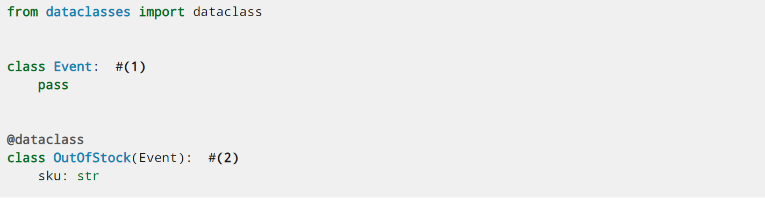
Seen…
Event base class
Identifying as a Python dataclass using a decorator

Slide 14
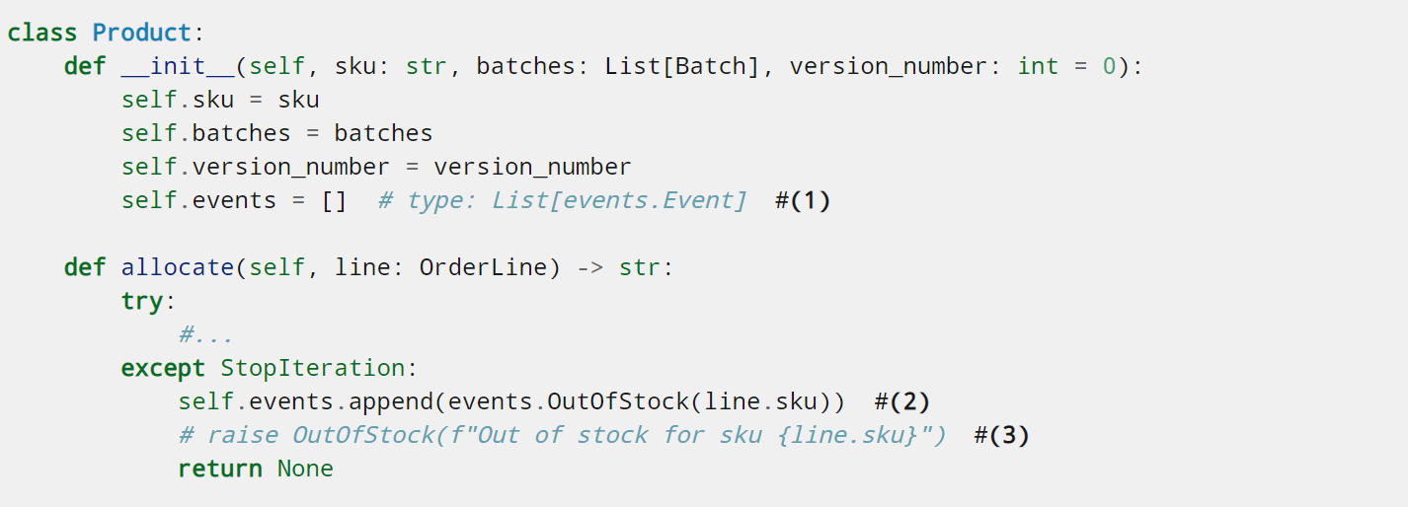
A Model will Manage its Own Events

Slide 15
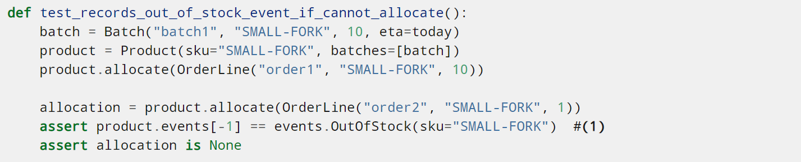
An Out-Of-Stock Test

Slide 16
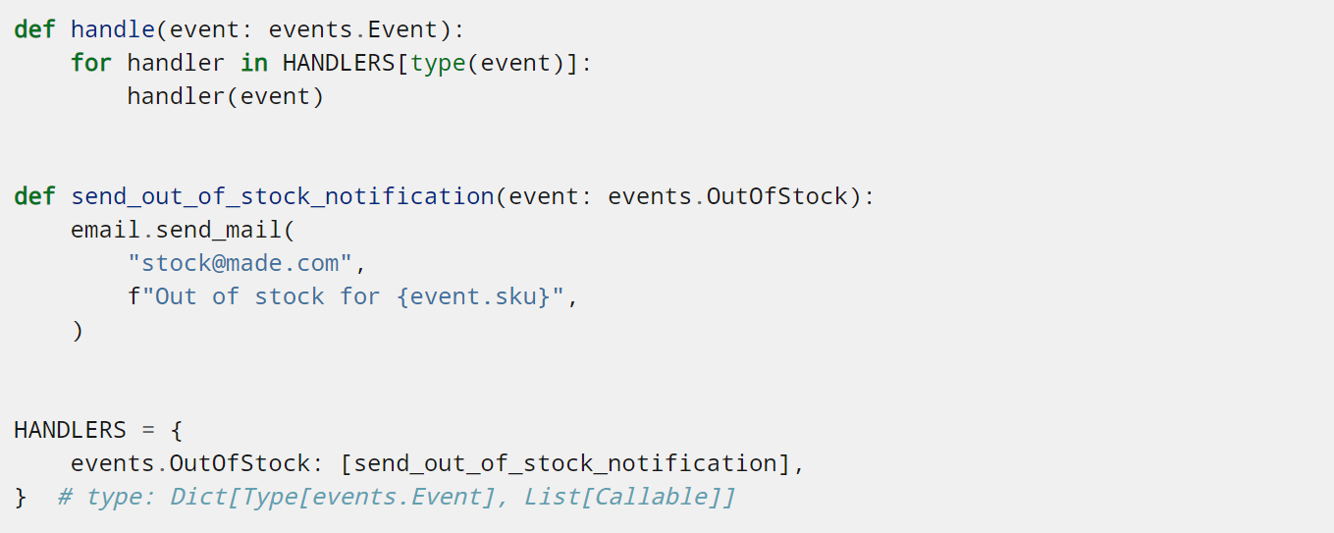
Event notification via Message Bus
A “bus” is a directed transmission path
We use this concept to develop a publish-subscribe system for events
We develop handlers which subscribe to the events raised by model objects

Slide 17
Who is responsible?
Service Layer?
The service layer could orchestrate the connection between model events and handlers as it handles requests (and thus state changes)
We could take this further by moving responsibility from the model such that the service layer recognizes, raises, and orchestrates the events
The Unit of Work?
Also sees all transactions and works when state will actually change
Understands all aggregates

Slide 18
Recap
Events can help with the single responsibility principle
A Message Bus routes messages to handlers
Implementation Options
Option 1: Service layer raises events and passes them to message bus
Option 2: Domain model raises events, service layer passes them to message bus
Option 3: UoW collects events from aggregates and passes them to message bus

Slide 19
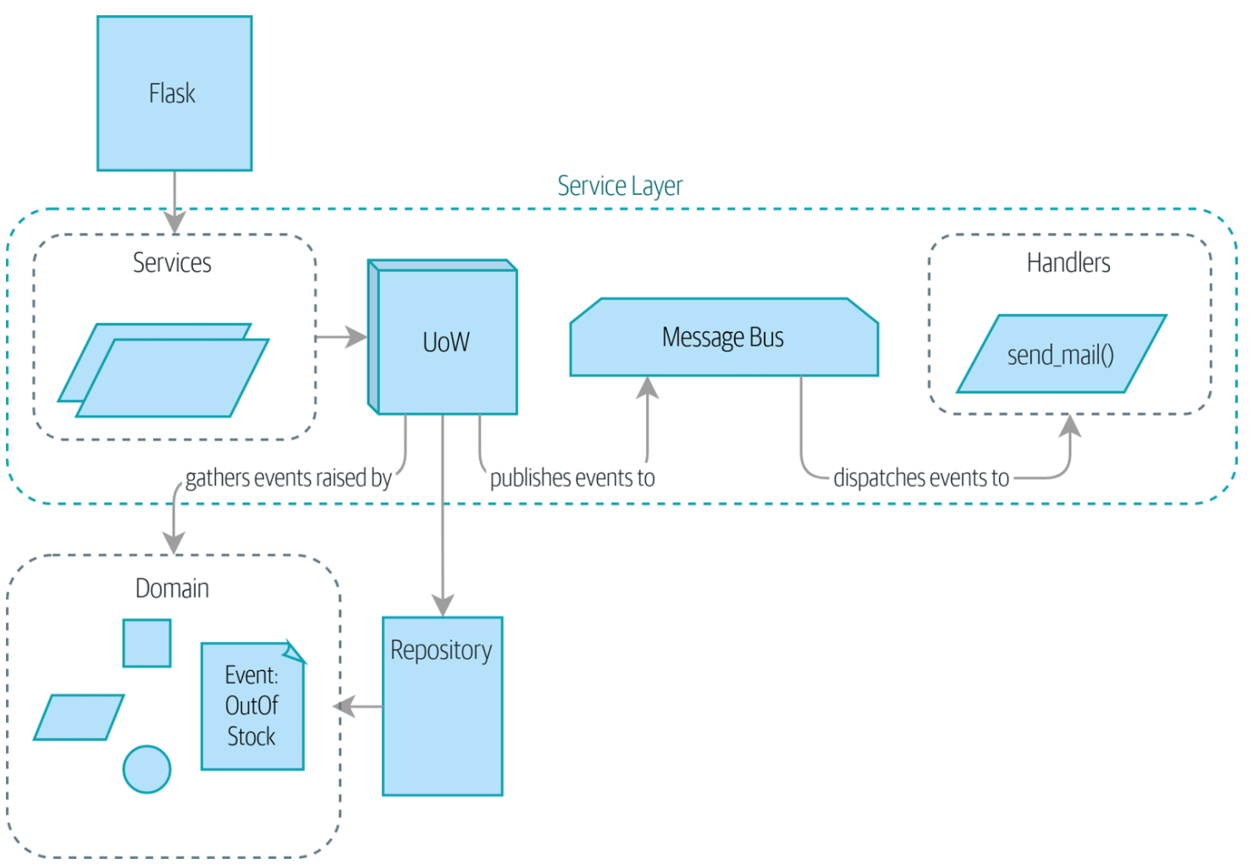
Message Bus Original Implementation

Slide 20
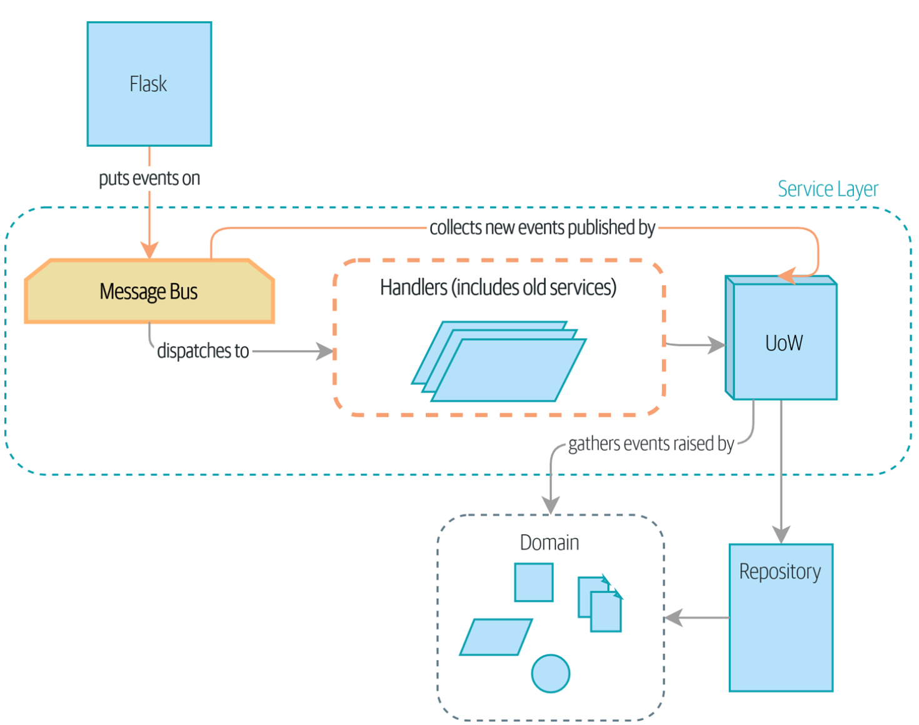
Message Bus as Interface

Slide 21
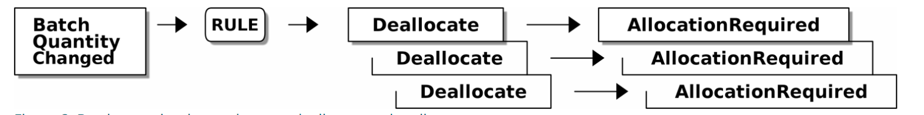
Everything is Call and Response

Slide 22
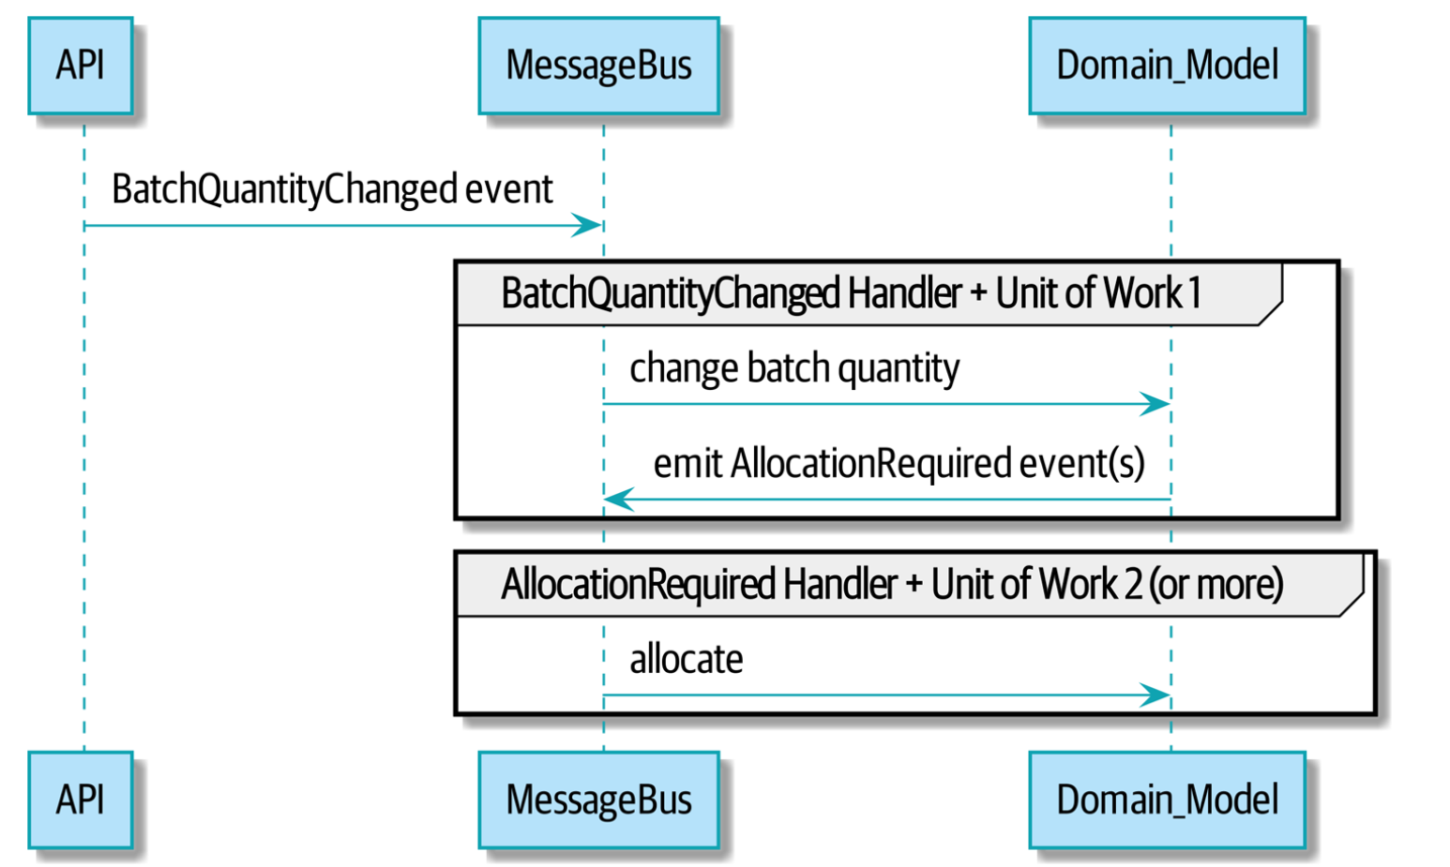
Cascades of Response

